Slide 1
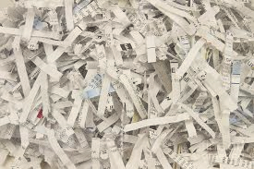

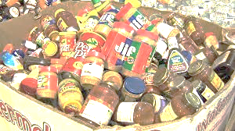
COMMUNITY RESIDENTIAL SHRED EVENT
THURMONT POLICE DEPARTMENT
800 EAST MAIN STREET
THURMONT MD 21788
April 29, 2017 8am- 12pm
Services Provided By:
sS
Sponsored by:
THURMONT POLICE DEPARTMENT & WOODSBORO BANK
ALL SHRED DOS – office paper, paper clips, staples, rubber bands, folders, hanging folders, labels.
ALL SHRED DON’TS – newspapers & magazines, binders, heavy plastics, cardboard, heavy metal, heavy carbon, trash, x-rays, floppy disks, CDs, batteries.
BENEFITS: THURMONT FOOD BANK
*Free when you Bring NON- PERISHABLE FOOD ITEMS WITH EACH BOX / 5 BOX LIMIT

